Slide 1

Let me cook
Friday, 12 April 2024
14:47

Slide 2






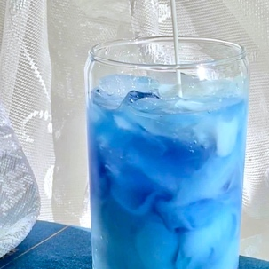

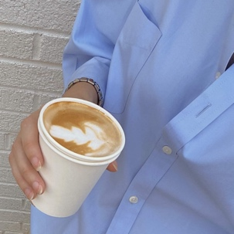





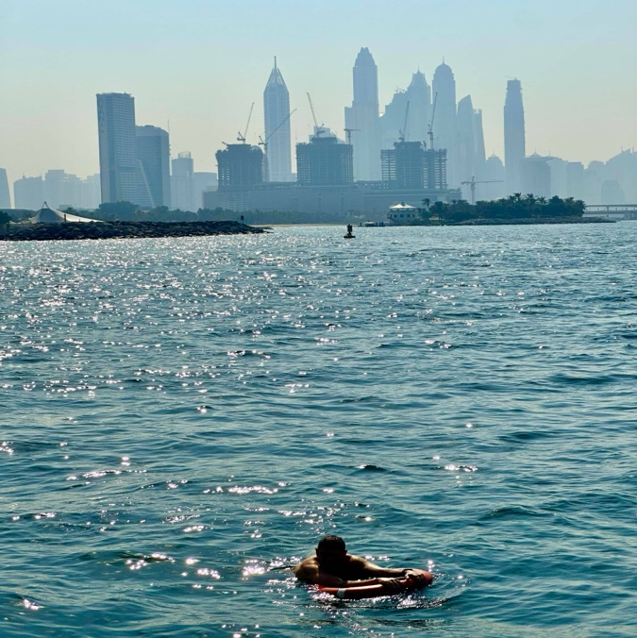


14:47
Friday, 12 April 2024
daily reminder
KeePer
The Boyz
create a life you can’t wait to wake up to
Improve sleep schedule
Reduce screentime
Learn how to surf
Read 20 books
Communicate and express myself
DON’T WISH FOR IT, WORK FOR IT
5
Goals

Slide 3
Reading list
Friday, 12 April 2024
Res 1
Res 2
Res 3
Res 4
Res 5

Slide 4
Goals for 2023
My lists
My Lists
🦋
Goals for 2023
Intentions
Watch list
5
8
47
◯ | /
◯ | //
◯ | ///
◯ | ////
◯ | //////
🧠
🍿

Slide 5


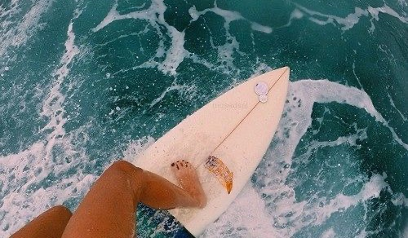
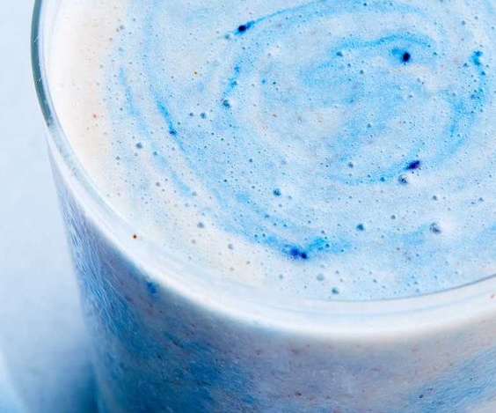

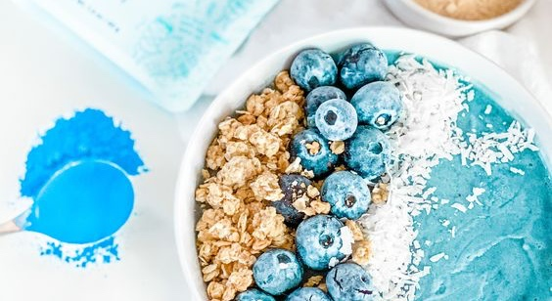



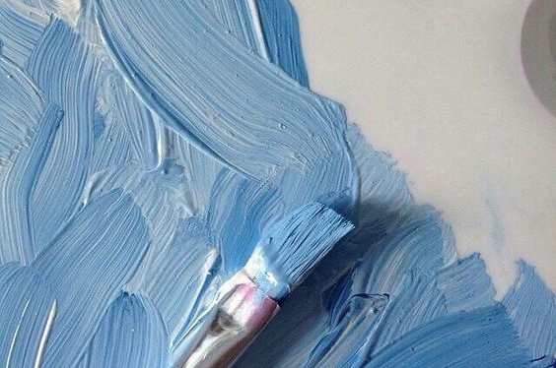
Replace

Slide 6

The powerhouse of the cell is one of the strongest quotes

